Slide 1

BHARAT INSTITUTE OF ENGG AND TECH Ibrahimpatnam-mangalpally
Disaster management system for disaster situatory in Hyderabad
Guidance:
Dr. R. MADANA MOHANA, CSE dept
Students:
V.Amruth – 16E11A05J0
K.Yeshwanth – 16E11A05H8
A.Nikhil - 16E11A05G7

Slide 2
Contents
Introduction
Abstract
System Analysis Architecture
UML diagrams
Experimental results
Conclusion

Slide 3
Abstract
This is an Android Application through which the citizens can report the bad situations related to various aspects. All they need to do is take a picture where the condition of the road is bad and upload it in the page. They need to mention the locality and if they wish they can add some content (E.g.; Since when the road has been like that, Any other specifications). In addition if there is any situation at a particular location the risk factors are classified.

Slide 4
Features
THIS App mainly has 4 functionalities: Education , Law and Order, Health , Transport and Others.
1. If there is an accident at a particular location the users can upload the situation will be updated so that the respected departments will respond.
2.Users can report about bad weather conditions like fog, heavy rainfall .
3. Users can report about Drainage system overflow.
4. Users can report about Building collapses and Falling of electrical poles.
5. Online human chat box.
6. Users can report about Severe Natural Calamities like earthquakes, tsunami and cyclone etc;

Slide 5
System Architecture
Three tiers of an app
APPLICATION
GUI
(android XML)
Business
Logic
(JAVA)
DATABASE
(sql)

Slide 6
APPS
Native App
Hybrid App
Web Application
 | client | server | client | server
UI | Android xml | JavaScript | Android Xml | HTML
Business logic | JAVA | Python | JAVA | python
Database | SQL lite | Oracle,mysql | x | Oracle
*for hybrid app the client and server side is same as native app

Slide 7
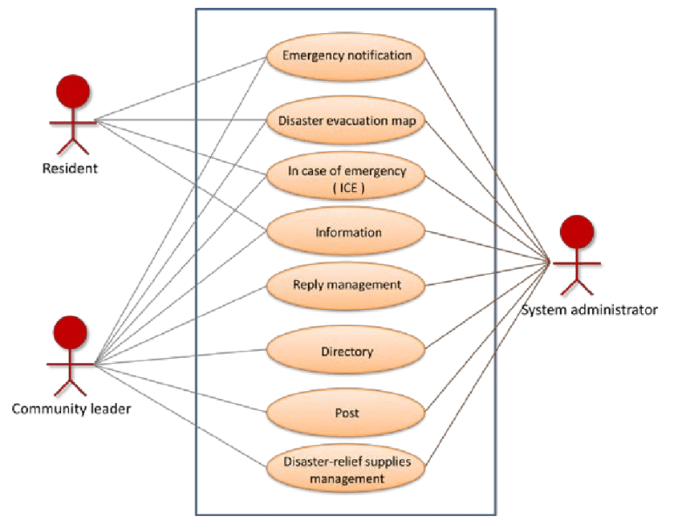

Slide 8
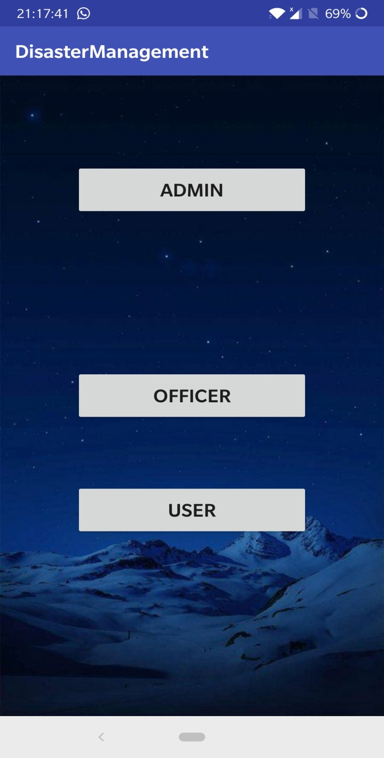
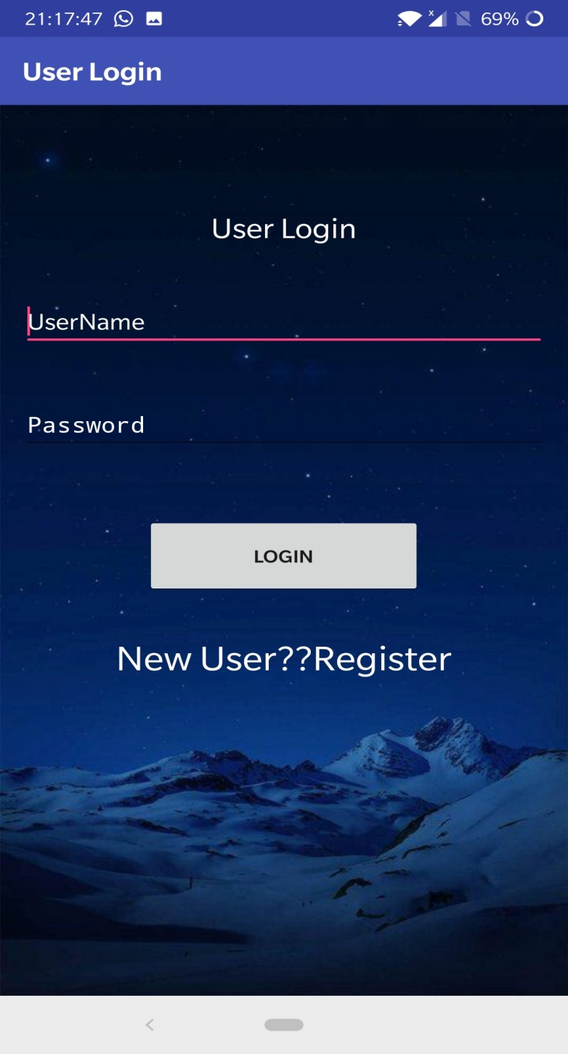
Screenshots of Prototype

Slide 9
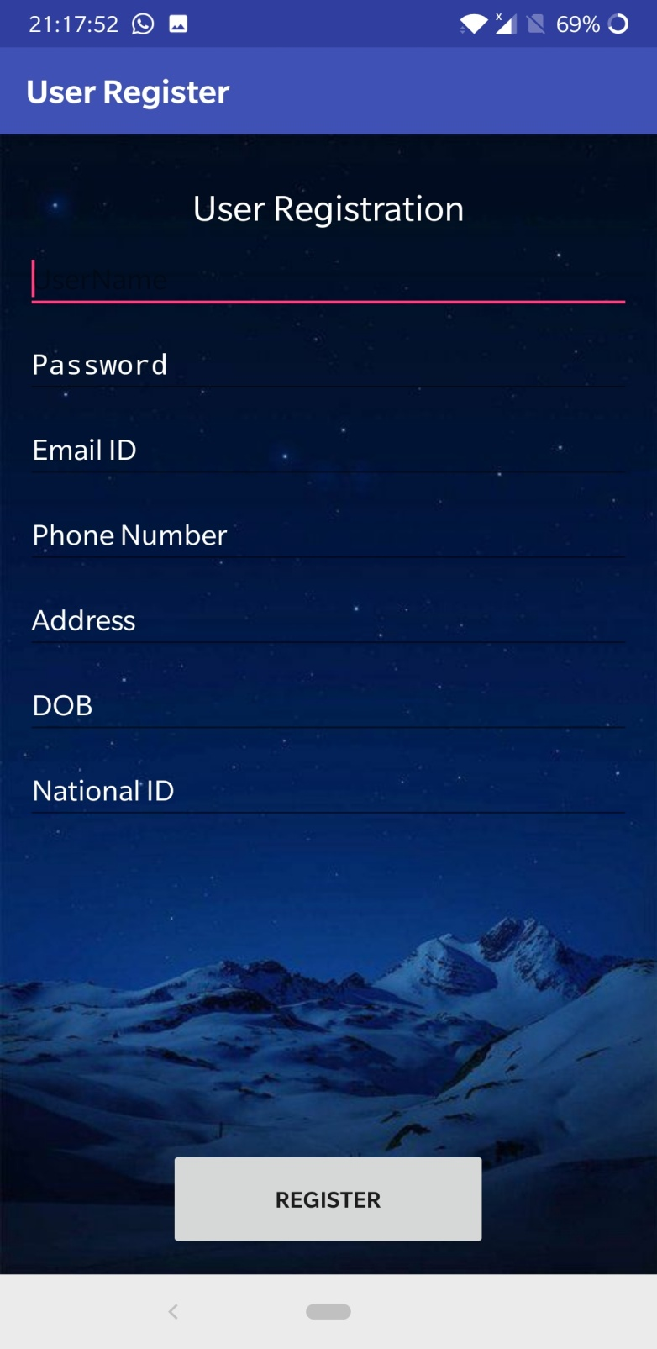
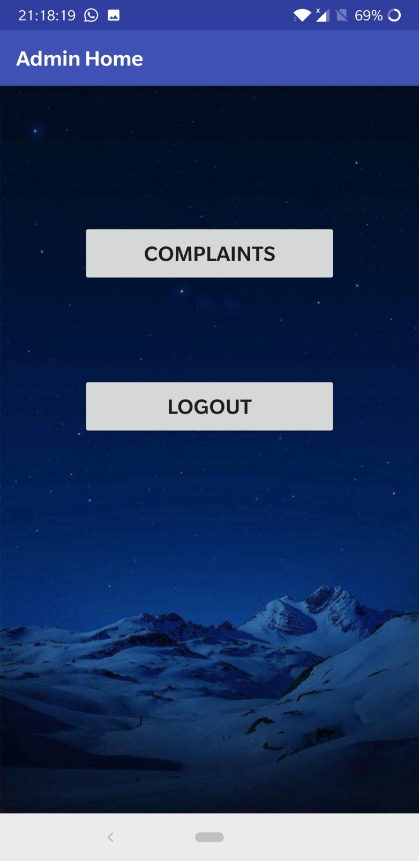

Slide 10
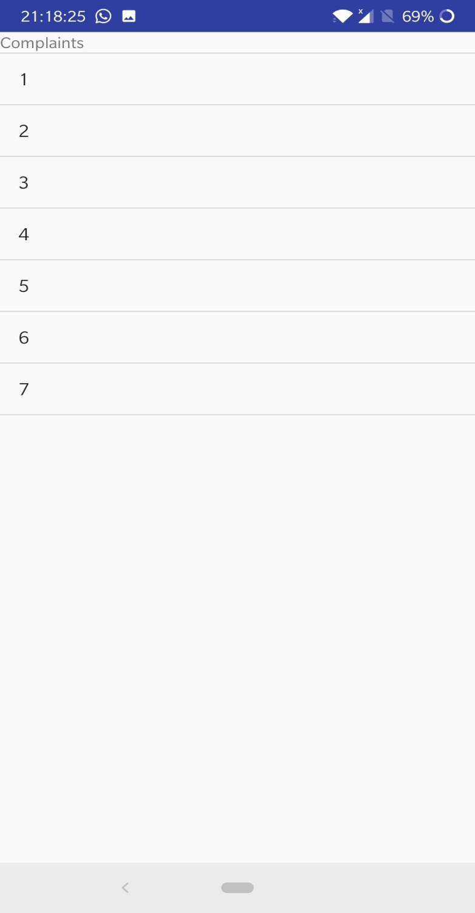
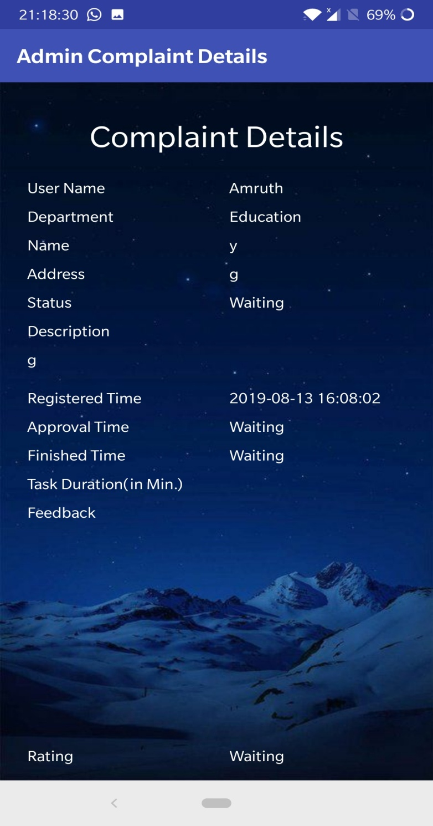

Slide 11
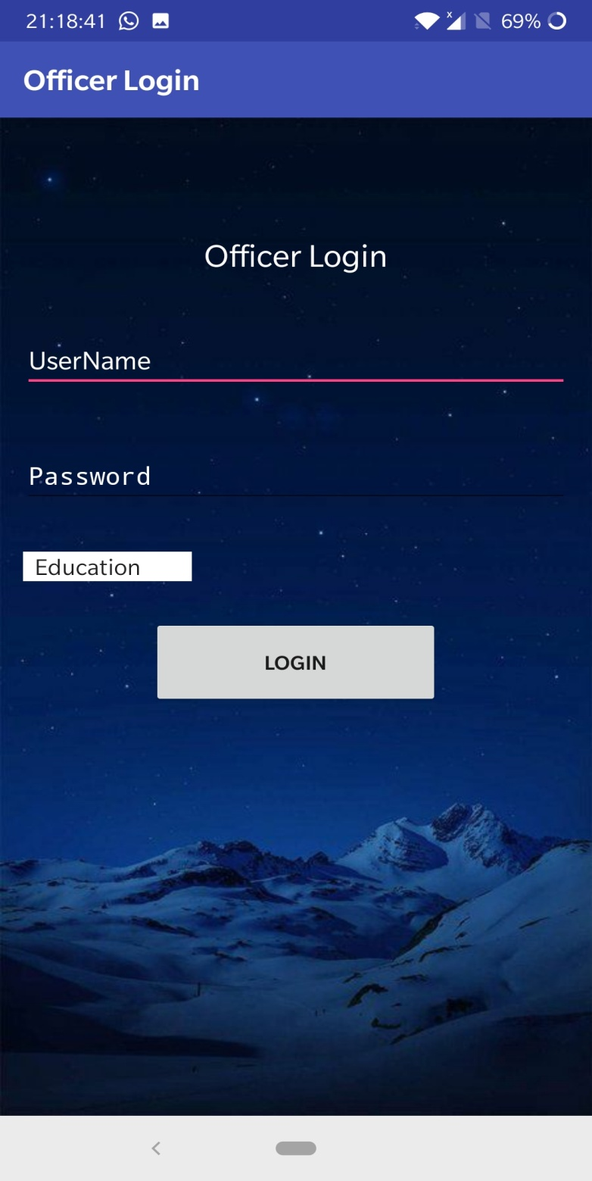
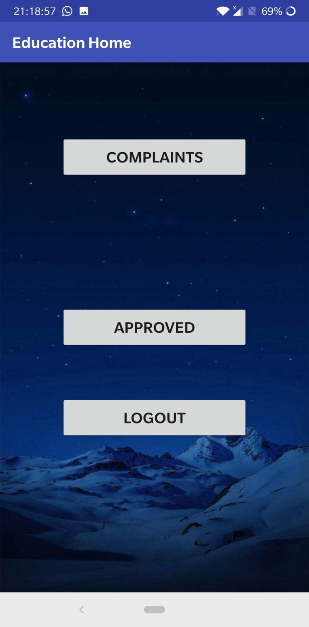

Slide 12
Conclusion
Thus the objective is to make an efficient app to handle disasters and improve the conditions.

Slide 13
THANK YOU

